Slide 1

Basic Details of the Team and Problem Statement
HackToFuture-2024
In Association with
The Institution of Engineers (India)
IEI Local Centre, Belagavi
Domain : Web /App Development
PS Code: WD-03
Problem Statement Title: Animal Tracking System- Use Case: Group Management and Alerts
Team Name: Tech Growth
Team Leader Name: Vaibhav Parab
Table Code Assigned: 2.8
Institute Name: Maratha Mandal Engineering College.

Slide 2
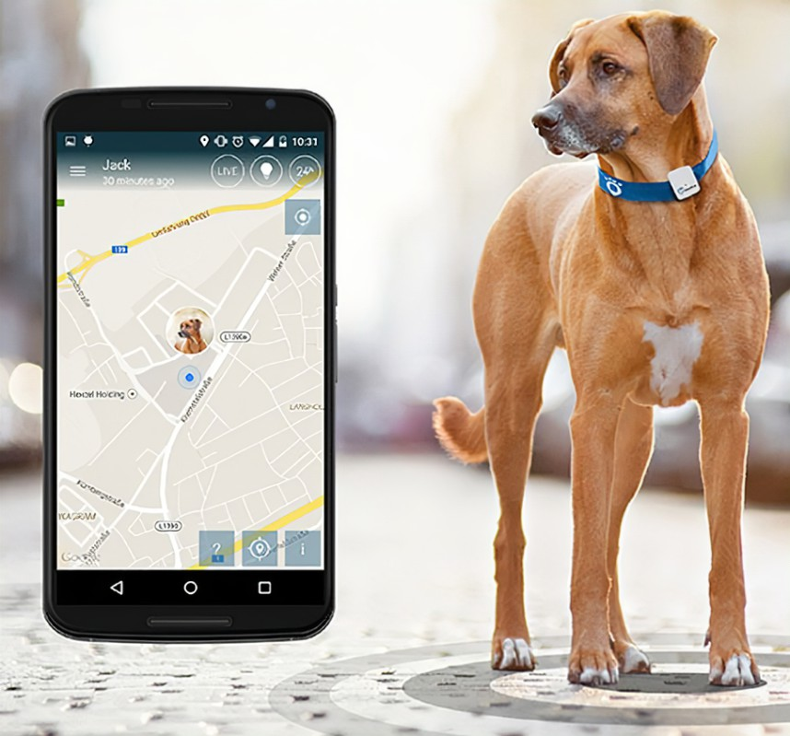
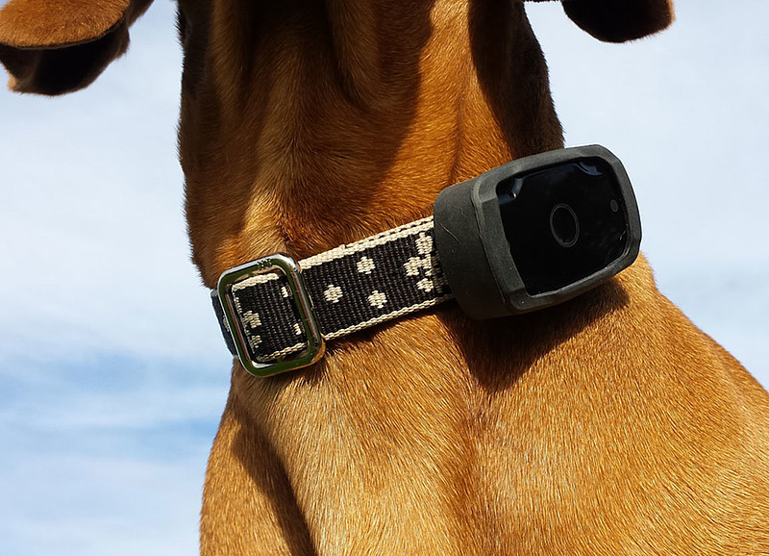
Introduction to Wild Track
WildTrack Overview: An advanced animal tracking system for group management and real-time alerts.
Backend Technologies: Utilizes Node.js and MongoDB to process and store animal location data received every 5 seconds from radio collars.
Grouping Algorithm: Assigns animals to groups based on proximity, triggering notifications if an animal leaves its assigned group.
Frontend Technologies: Built with React Native and Leaflet open source Maps, providing map visualisation of animal locations and group boundaries.
Real-Time Features: Offers real-time updates and configurable group settings for users.
Purpose: Enhances wildlife management and research through efficient data processing and dynamic mapping.

Slide 3
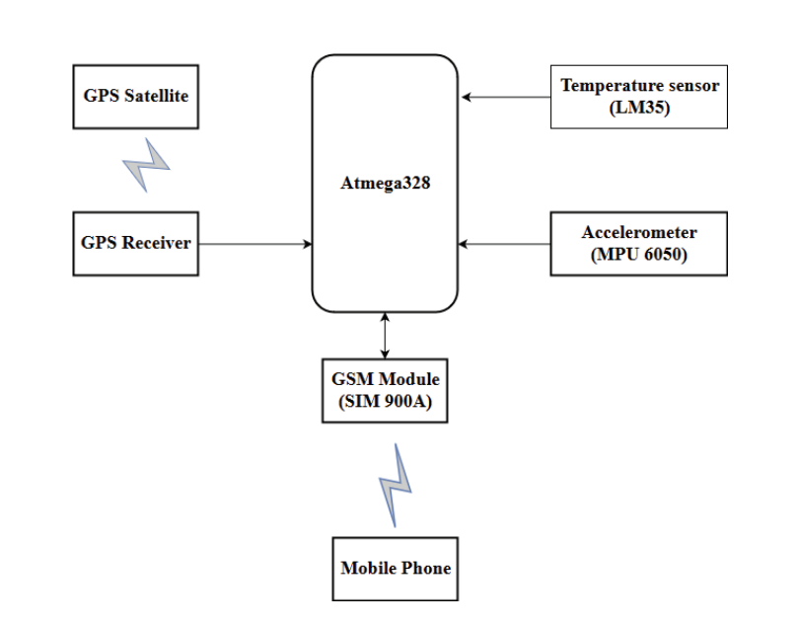
Block Diagram

Slide 4
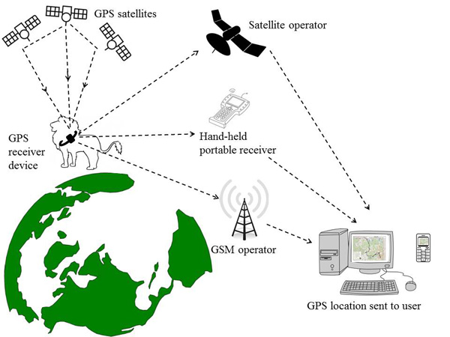
Wireless Communication system

Slide 5
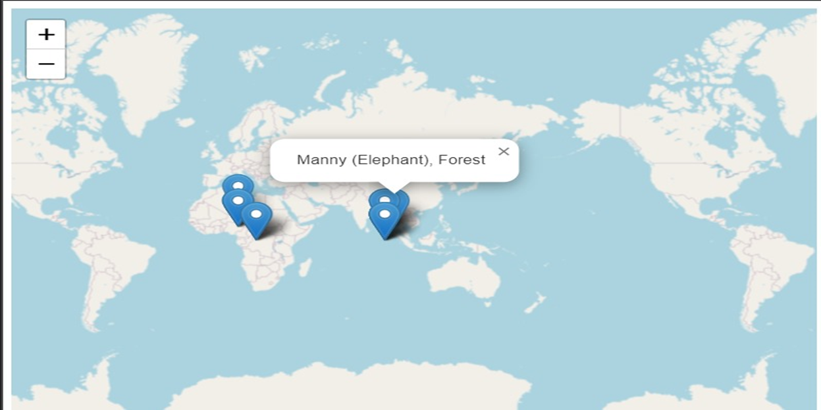
Generating Animal Tracking Data on Maps
Overlay animal movement data onto geographical maps.
Visualize migration patterns, habitat use, and daily movements.
Identify key locations like breeding grounds or feeding areas.
Create interactive maps for data exploration and sharing.
Map Visualization
Number of Animals: For a small number of animals, individual movement paths might be most informative.
For large datasets, heatmaps or summary statistics might be more useful.
Data Type: If additional data like speed or environmental factors are available, overlaying them on the map can provide deeper insights.

Slide 6
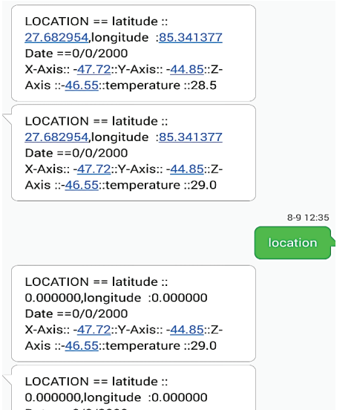
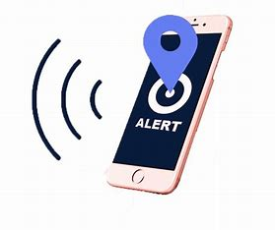
SMS Alert Messages
Receive instant notifications on animal movement
Enhance response time for emergencies or conservation efforts.
Alert researchers of unusual behaviour or potential threats.
Allow for real-time monitoring of animal movements outside designated areas.

Slide 7
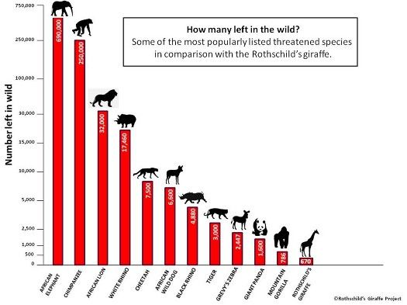
Graphs Depict Animal Behaviour
Animal Behaviour Through Graphs
Analyze activity levels, sleep patterns, and movement speeds.
Identify correlations between behavior and environmental factors.
Understand how animals adapt to changing conditions.
Gain insights into foraging patterns and resource utilization
Animal tracking data can be translated into graphs, revealing patterns in animal behaviour.

Slide 8
Benefits
It is useful to collect information about the animal behaviour.
Researchers can make better environment for animals.
It aids in study of migratory behaviour.
Humans entering animal habitats endanger certain species.

Slide 9
Conclusion
The designed system has three major functions; first of all it can track the location then monitor the health status, finally alert the user in two different ways i.e. on the request basis or the direct alert.
By increasing the other sensors hygienic parameters of animal can be determined. Hence, by using GPS and GSM technology it is possible to locate animals and monitor their health issues

Slide 10

THANK YOU

